Slide 1


Slide 2
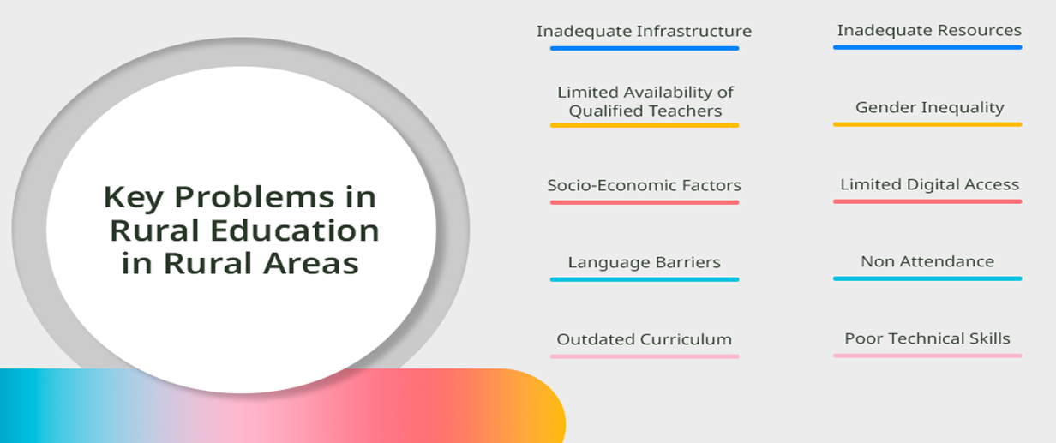
Challenges in
RURAL EDUCATION :
Limited Infrastructure and Resources
Teacher Shortages and Training Gaps
Many rural schools lack basic facilities like electricity, reliable internet, or modern classrooms.
Rural areas often have fewer qualified teachers
Impact: Instruction quality suffers, and students disengage from rote learning methods.
Language and Cultural Barrier
Geographic Isolation
Rural communities often speak local or indigenous languages not used in standard curricula, which are typically in national languages
Rural students may travel long distances to school, facing safety risks or seasonal barriers

Slide 3
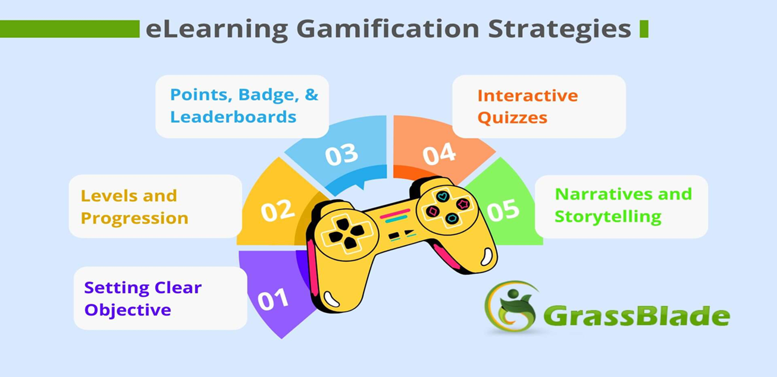
WHY GAMIFIED LEARNING ?
Gamification applies game design elements to non-game contexts like education.
Makes learning interactive and fun to boost motivation.
Core elements include: Quizzes for testing knowledge.
Rewards and badges for achievements Storytelling to create immersive narratives.
Levels and progress tracking for a sense of accomplishment.

Slide 4
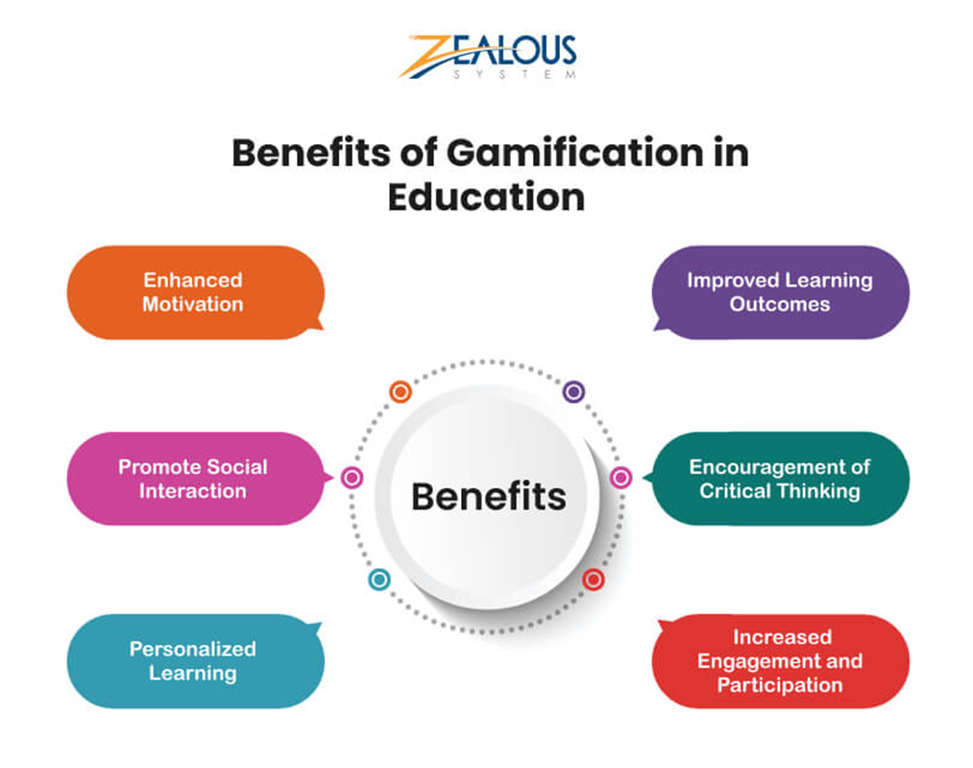
FEATURES :
🎮 Levels & Rewards: Students progress through levels by completing quizzes and activities. Rewards like stars or badges encourage consistent learning.
🌐 Multi-language Support: Lessons available in regional languages such as Hindi, Tamil, Telugu, Kannada, Malayalam, and Bengali for better understanding.
📱 Offline Access: Works even without internet, ensuring usability in areas with poor connectivity.
📚 Curriculum-Based Content: Covers subjects like Maths , Science, and Languages from classes 1 to 10.
🧩 Interactive Quizzes & Stories: Uses storytelling, puzzles, and visual learning to simplify complex topics.
👩‍🏫 Teacher Dashboard: Allows teachers to track student progress and performance.

Slide 5
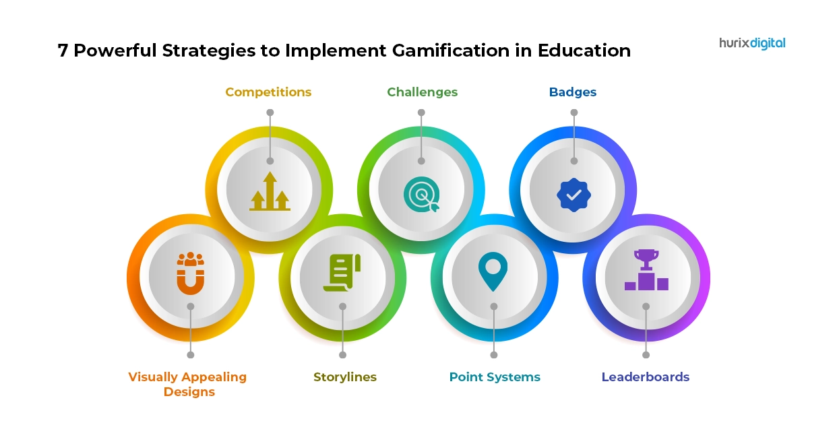
IMPLEMENTATION:
Develop using cross-platform tools like Flutter for Android/iOS compatibility
Content creation: Partner with educators for localized, story-driven modules
Distribution: Pre-load on affordable tablets or via community hubs.
Examples: Similar to apps like Duolingo but offline-focused, or custom builds for rural programs
Monitoring: Built-in analytics for teachers to track
progress

Slide 6
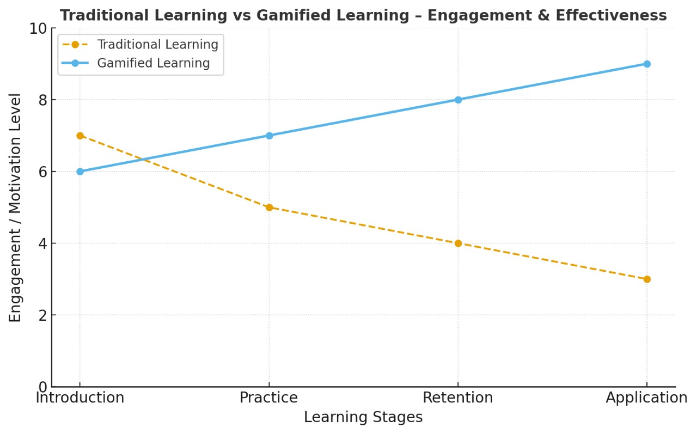

Slide 7
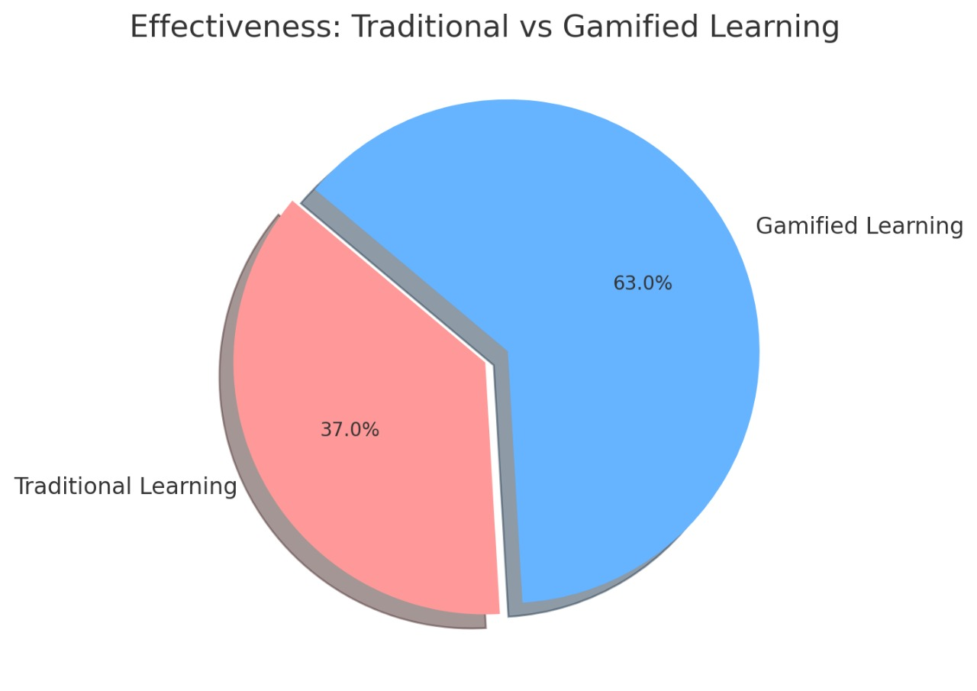

Slide 8
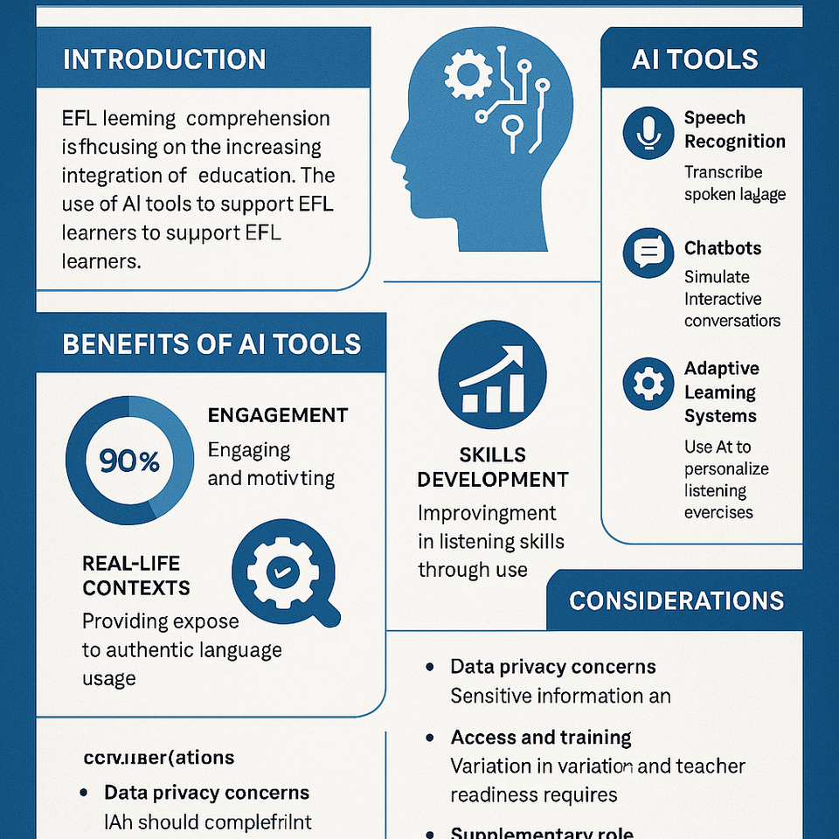
IN FUTURE:
IN FUTURE HOW AI WILL IMPACT THIS PLATFORM: 1) It automatically adjusts the difficulty level. If a student finds the topic easy AI promotes difficult questions, if difficult it promotes easy to moderate questions. 2) It finds the mistakes rapidly and gives the correct solution which reduces frustration of students when they are stuck. 3) AI can suggest relevant topics, exercises and quizzes on what the student is studying. 4) It also predicts where they might struggle in future. HOW QUANTUM TECHNOLOGY WORKS
IN FUTURE HOW WE CAN USE QUANTUM IN THIS PLATFORM: 1) It works on cubits instead of bits. So, it works even more faster. 2) So multiple solutions can be analyzed at a time. 3) Because of superposition and entanglement, it performs many calculations at a time. 4) Can run complex activities without slowing down the app, even if many students use the app simultaneously. 5) High accuracy.

Slide 9

CONCLUSION :
Gamified platforms can transform rural education by making it engaging and accessible.
Key to success: Offline capabilities, multilingual support, and fun elements like quizzes and rewards.
Call to action: Invest in and deploy such solutions to bridge the urban-rural education gap.
Future potential: Integrate AI for adaptive learning while keeping it lightweight

